Slide 1
Broadband Assessment and Action Planning
San Augustine County
Broadband Survey Results
April 1, 2021
Communities want
Accurate broadband maps and data at the local level
Student access to online resources to succeed outside the classroom
Connectivity to support telehealth and improve overall rural access to healthcare services
Local planning resources to stimulate broadband infrastructure investment
State leadership to respond to local needs and proactively coordinate broadband activities and policies
Efficient ways to identify and pursue funding and resources
Pam Waggoner
Broadband Solutions Manager, Connected Nation Texas

Slide 2
Agenda:
San Augustine County Broadband Survey Results
Agenda:
Review of Broadband and Sectors surveyed
Broadband Survey Metrics
Sector Survey Results
Initial Recommendations for San Augustine County
Next Steps

Slide 3
San Augustine County Broadband Survey Metrics
Survey Period: July 2020- Feb 2021
The survey will highlight areas of access, adoption, and use of broadband over a variety of sectors.
Residential, Business, Healthcare, K-12, Higher Ed, Library, Public Safety, Agriculture
As a reminder: Broadband connections are always on. Fixed connections are those provided by cable, DSL, fiber, or fixed wireless technology, while non-fixed connections include dial-up, satellite, and mobile-only services

Slide 4
San Augustine County Broadband Sectors’ Results
San Augustine County | Suggested Min. | Total Responses | Total Responses2 | Total Responses3 | Total Responses4 | Total Responses5 | Total Responses | Total Responses6
Sectors | Target | 13-Dec.2020 | 03-Jan.2021 | 10-Jan.2021 | 17-Jan.2021 | 1/24/2021 | 1/31/2021 | 2/7/2021
Residential | 340 | 203 | 268 | 294 | 299 | 301 | 302 | 303
Business | 30 | 13 | 16 | 17 | 18 | 18 | 18 | 18
Public Safety | 3 | 3 | 3 | 3 | 3 | 3 | 3 | 3
Library & Community Org | 1 | 1 | 1 | 1 | 1 | 1 | 1 | 1
Agriculture | 30 | 3 | 7 | 7 | 7 | 7 | 7 | 7
K-12 Education | 7 | 1 | 3 | 4 | 4 | 4 | 4 | 4
Higher ED | 0 | 0 | 0 | 0 | 0 | 0 | 0 | 0
Healthcare | 1 | 1 | 1 | 1 | 1 | 1 | 1 | 1
Government | 3 | 2 | 2 | 2 | 2 | 2 | 2 | 2
Totals | 415 | 227 | 301 | 329 | 335 | 337 | 338 | 339

Slide 5
residential/houseHOld survey

Slide 6
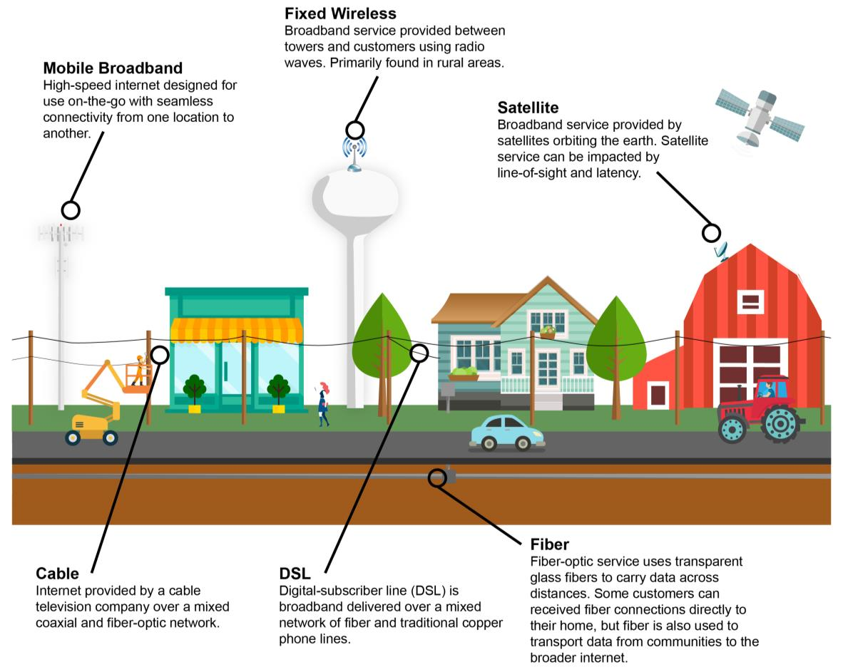
Residential: Broadband Connection
Broadband Access, Adoption, and Use
What type of internet service does your household subscribe to? San Augustine County has less fixed broadband adoption than other CN communities.

Slide 7
Residential: Mobile Internet Use
Broadband Access. Adoption, and Use
How is mobile Internet being used in San Augustine County?

Slide 8
Residential: Devices at Home
Broadband Access, Adoption, and Use
A wide variety of devices are now available to connect to the internet. The chart shows the average number of internet-enabled devices in households in the community compared to homes in other Connected communities.
Why is it important to know this? The more devices, the more bandwidth you need. The lack of devices also is considered a barrier to home broadband adoption.

Slide 9
Residential: Internet Speeds
Broadband Access, Adoption, and Use
The FCC defines a broadband connection at a minimum of 25 Mbps download and 3Mbps uploads.
In San Augustine County Broadband, service with speeds at least 25/3 Mbps stats:
2,360 Unserved Households - 34.9% Household Availability
San Augustine County Broadband Survey Summary:
Households Residential Findings
Connection speeds can have a major impact on how the internet is used. This chart shows the average reported download speed among households in the community compared to those in other Connected communities

Slide 10
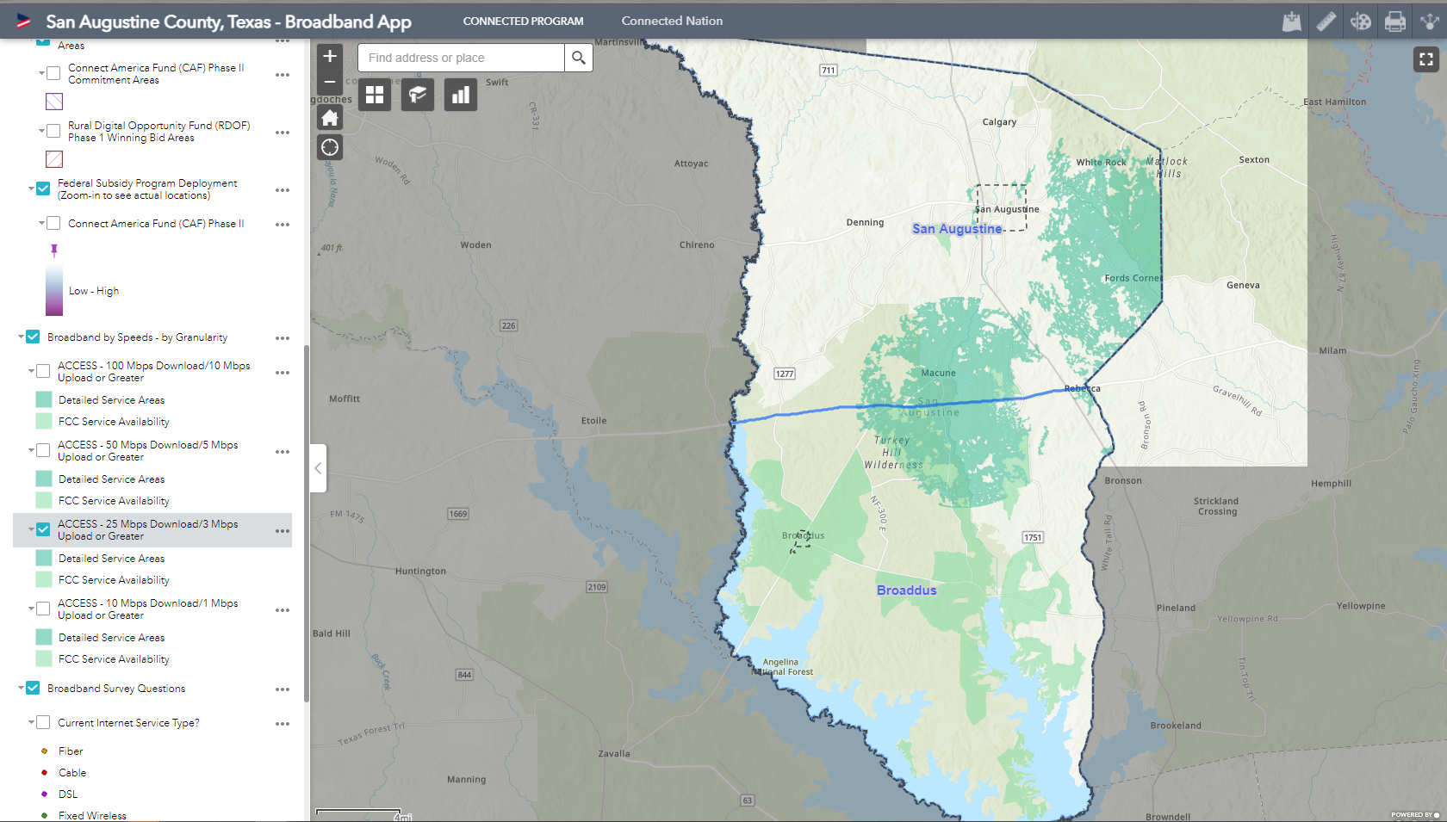
San Augustine County:
Broadband 25M/3M

Slide 11
Residential: Service
Broadband Access , Adoption, and Use
This chart shows the primary reason households without a connection in the community do not or cannot subscribe to broadband service. This chart compares households in the community to those across other participating communities.

Slide 12
Business Survey

Slide 13
Business: Connections
Broadband Access, Adoption and Use
This chart shows the percent of businesses that subscribe to various types of broadband
18 businesses responded to this survey and say they have an internet connection!

Slide 14
Business: Digitally Interact
Broadband Access, Adoption, and Use
How often do you interact with local and non-local (i.e., those within 50 miles of the community and those farther than 50 miles, respectively)?

Slide 15
Business: Teleworking
Broadband Access, Adoption, and Use
Top 5 Remote work industries: Between 2018-19 Texas remote jobs grew by 48% as reported by virutalvocations.com
Information Technology Sales Healthcare,
Account Management Customer service.
More teleworking days translates into fewer hours on the road, more time saved, and fewer greenhouse gasses released into the atmosphere.

Slide 16
Business: Teleworking
Broadband Access, Adoption, and Use
Teleworking:
This chart shows how many employed survey respondents telework, compared to other Connected communities.

Slide 17
Agriculture Survey

Slide 18
Agriculture: Connections
Broadband Access, Adoption, and Use
Technology has also changed the agriculture industry:
Record keeping Estimation of Production Predictions of Weather conditions
Calculation of Profit Communication among farmers
Information on soil conditions/drainage
The percent of agricultural producers that subscribe to various types of broadband services or that are without a connection.

Slide 19
Agriculture: On-line Activities
Broadband Access, Adoption, and Use
San Augustine’s agriculture community related online activities

Slide 20
Agriculture: Barriers
Broadband Access, Adoption, and Use
What are the barriers agriculture producers are facing?
Agriculture: Barriers
Broadband Access, Adoption, and Use

Slide 21
K-12 Survey

Slide 22
K-12: Device Program
Broadband Access, Adoption, and Use
One-to-one device programs across schools in the community compared to schools in other Connected communities.

Slide 23
K-12: Community Communication
Broadband Access, Adoption, and Use
The frequency with which K-12 schools in the community use various digital tools to communicate with the public.

Slide 24
K-12: Community Interaction
Broadband Access, Adoption, and Use
This chart shows the frequency with which residents in the community report that they digitally interact with K-12 institutions. Increasing K-12 and Higher Eds visibility in the community is necessary when trying to pass bonds and inform the citizens of news.

Slide 25
K-12: Community Interaction
Broadband Access, Adoption, and Use
Competition provides communities with choices for service, allowing them the ability to switch providers if their current service does not meet their needs. This chart shows the percent of K-12 institutions who state that their internet service meets or does not meet their needs.

Slide 26
Other Sectors:
Higher Ed
Government
Public Safety
Library/Community Organizations
Health Care

Slide 27
Higher Ed: On-line Degrees
Broadband Access, Adoption, and Use
The percent of higher education institutions offering degrees that students can complete entirely online.

Slide 28
Government: Service Satisfaction
Broadband Access, Adoption, and Use
Various reasons why government subdivisions report being dissatisfied with their current internet service

Slide 29
Government: Digital Communications for Civic Participation Broadband Access, Adoption and Use
There are many ways in which a political subdivision can leverage technology to improve civic participation.
Government: Digital Communications for Civic Participation Broadband Access, Adoption and Use

Slide 30
Public Safety: Service Satisfaction
Broadband Access, Adoption, and Use
The percent of public safety agencies who state that their internet service meets or does not meet their needs.

Slide 31
Public Safety: Dissatisfaction Reasons
Broadband Access, Adoption, and Use
Why local public safety agencies report being dissatisfied with their current internet service.

Slide 32
Libraries and Community Organizations: Technology Offerings
Broadband Access, Adoption, and Use
The many ways a library and other organization can leverage technology to improve the services they offer to the public and the ways in which patrons access information. This chart shows the use and interest in a variety of technologies among libraries and other organizations in the community.

Slide 33
Libraries/Community Organizations: Service Satisfaction
Broadband Access, Adoption, And Use
This chart shows the various reasons why libraries and community organizations report being dissatisfied with their current internet service.

Slide 34
Health Care: Digital Communication
Broadband Access, Adoption, and Use
The average frequency with which local health care facilities use these digital communications tools.

Slide 35
Health Care: Residents Interaction with Health Care
Broadband Access, Adoption, and Use
Measuring the frequency with which residents in the community report that they digitally interact with facilities in the health care sector.

Slide 36
Recommended Actions

Slide 37
Proposed Recommended Actions
Become a Digital Ready Community – What does this mean?
2. Develop a San Augustine Technology Action Committee
3. Identify and promote low-cost broadband services offerings for the community, specifically for vulnerable populations.
4. Improve Public Safety communications;
5. Speeds and Reliability Telemedicine (or telehealth) can help to address challenges associated with living in sparsely populated areas and having to travel long distances to seek medical care—particularly for patients with chronic illnesses. It also addresses the issue of the lack of medical specialists in remote areas.
6. Decrease the cost of broadband in San Augustine County
7. Educate San Augustine leaders and the community about the Federal money coming into the county. RDOF money can change the landscape of broadband in San Augustine County if the community and providers are working together.
8. Enact strategies that promote fixed broadband access San Augustine County residents are already teleworking.
9. Provide support and attraction program.
10. Offer classes in website, social media, cybersecurity, and internet
access to businesses and the residents.

Slide 38
San Augustine County: Recommended Action Plan
Goal 1: Become a Digital Ready Community – What does this mean?
A community with 100% high-speed internet that is open and ready to do business with the residents, local and outside businesses, and making information easily accessible to vendors and others wanting to connect in your county.
Appointed liaison who can educate San Augustine County leaders and the community about broadband and why access, adoption, and use are important. This person should understand how state and federal grants work and be accountable for incoming money from a variety of federal and possible state programs the county will be receiving.
Digital skills and access to training – skills needed to get on-line
High speed internet availability at 100%.
Customer ready – online information for those seeking to do business in your community, online forms available for residents and vendors,

Slide 39
San Augustine County: Recommended Action Plan
Objective: How do we reach the goal!
Solicit and secure cities and county entities’ commitment to becoming a digital ready community in the next 6 months.
Action 1:
Appoint single point of contact within the local government.
This can be done by full-time or part-time hiring/providing a stipend/ re-organizing work loads/ sharing cost between entities, etc.…
Use resolutions or MOUs stating needs and goals,
Incorporate internet needs within the budget.
Goal:
Streamline processes by eliminating unnecessary policies, consolidating information, and appointing a single point of contact that can ensure that the community is operating as efficiently as possible with providers and other parties.
Actions:
This group shall appoint a single point of contact for all telecommunications infrastructure development projects..

Slide 40
San Augustine County: Recommended Action Plan
Who is in charge:
The development and organization of a liaison’s office begins with the Champion of this survey, John Camp, San Augustine City Manager. He will guide the process through the appointing of a liaison and developing the office.
Once a Liaison is appointed, all responsibilities and duties move that office. This department can be part of the Economics and Development office, San Augustine Treasury Department, a stand-alone committee residing under the San Augustine city council or County Commissioners’ Court responsibilities, or something else that works best for San Augustine County.
The appointee will be responsible for anything to do with securing and promoting broadband in San Augustine County and reporting back to local government all progress. This person will engage local stakeholders when forming committees and seeking advice from the community. Local stakeholders include residents, business owners, vendors, internet providers, local utility companies, elected and appointed officials, public safety entities, and others.
Goal:
Streamline processes by eliminating unnecessary policies, consolidating information, and appointing a single point of contact that can ensure that the community is operating as efficiently as possible with providers and other parties.
Actions:
This group shall appoint a single point of contact for all telecommunications infrastructure development projects..

Slide 41
San Augustine County: Recommended Action Plan
Goal:
Streamline processes by eliminating unnecessary policies, consolidating information, and appointing a single point of contact that can ensure that the community is operating as efficiently as possible with providers and other parties.
Actions:
This group shall appoint a single point of contact for all telecommunications infrastructure development projects..
Action 2:
Review how vendors communicate with the San Augustine County: Review and update any San Augustine County websites with detail information about how to do business with the County. Currently, there are no websites or information accessible to vendors to do business with the County. Websites that should be included are https://www.co.san-augustine.tx.us/, and https://www.cityofsanaugustinetx.gov/administration/page/service-providers. There is a page that is dedicated to service providers on the San Augustine City website, but it is incomplete. Other websites that should be linked to “how to do business in San Augustine County” include https://www.facebook.com/SanAugustineChamber, and https://www.facebook.com/broaddusmayor/ .
Online forms should be made available to vendors.

Slide 42
San Augustine County: Recommended Action Plan
Responsible Party:
The dedicated liaison should be responsible to get this done.
Why? There is money coming into San Augustine County from Coronavirus State and Local Funds and some of the that money should be dedicated to bringing Wi-Fi into the county. Making sure the funds are used efficiently for the benefit of all the residents is a priority.
Through the RDOF auction and once final approvement is given by the FCC, Charter Communications is set to speed $6,417,525 in the County bringing Wi-Fi of at least 25/3 speed, although they have stated it will be Gigibits. Having a dedicated person to build a relationship with Charter Communications and coming to agreements on decisions about infrastructure, barriers to service, etc.… will benefit San Augustine County. It will also help decide how to spend additional monies the county may receive on supplementing the broadband deployment.
Goal:
Streamline processes by eliminating unnecessary policies, consolidating information, and appointing a single point of contact that can ensure that the community is operating as efficiently as possible with providers and other parties.
Actions:
This group shall appoint a single point of contact for all telecommunications infrastructure development projects..

Slide 43
San Augustine County: Recommended Action Plan
Resources:
Removing barriers to broadband expansion http://www.connectmycommunity.org/wp-content/uploads/2016/09/Local-Policy-Guide.pdf
Example of County with on-line resources - https://onlinepermits.mcallen.net/Portal/default.aspx
Becoming Broadband Ready https://nextcenturycities.org/becoming-broadband-ready/
Examining state broadband programs - https://www.pewtrusts.org/en/research-and-analysis/reports/2020/02/how-states-are-expanding-broadband-access
Goal:
Streamline processes by eliminating unnecessary policies, consolidating information, and appointing a single point of contact that can ensure that the community is operating as efficiently as possible with providers and other parties.
Actions:
This group shall appoint a single point of contact for all telecommunications infrastructure development projects..

Slide 44
San Augustine: Recommended Actions
2. Develop a San Augustine Technology Action Committee
Goal:
Establish and promote an empowered group of interested and passionate individuals to focus on broadband related needs and actions to benefit San Augustine County.
Action:
One key responsibility of this Committee is to manage and drive completion of the Technology Action Plan, while also serving as the “go to” resources for broadband related needs, questions and information across the county. This committee should plan on staying together for several years and recruit new members over the years.

Slide 45
San Augustine: Action Recommendations
3. Identify and promote low-cost broadband services offerings for the community, specifically for vulnerable populations.
Goal:
Help address the cost barrier to broadband adoption
Actions:
Promote the availability and use of low-cost monthly broadband programs for eligible households offered by State and National providers
https://www.fcc.gov/broadbandbenefit
Provide a Market Analysis to identify underserved areas, identify potential broadband providers, understand potential service offerings and rates.
Effectively target truly unserved and underserved areas. Helps providers gage interest and future infrastructure. Allows for shelve ready plans when budgets and grants allow for additional funds.
Providers may have programs the residents do not know about.
Involve providers in these discussions.

Slide 46
San Augustine County: Recommended Actions
4. Improve Public Safety communications; Speeds and Reliability.
Goal:
Leverage broadband technologies to enhance emergency communications to and from the public.
Actions:
Perform speed tests during peak hours to get a better understanding of user experience at these locations.
Facilitate planning meetings with local providers to determine cost saving options while increasing speed., Identify funding sources to pay for infrastructure updates (e-Rate for libraries). Incorporate technology needs in annual budgets/plans.

Slide 47
San Augustine County: Recommended Actions
Telemedicine (or telehealth) can help to address challenges associated with living in sparsely populated areas and having to travel long distances to seek medical care—particularly for patients with chronic illnesses. It also addresses the issue of the lack of medical specialists in remote areas by awarding access to specialists in major hospitals situated in other cities, states, or countries. While telemedicine can be delivered to patient homes, it can also be implemented in partnership with local clinics, libraries, churches, schools, or businesses that have the appropriate equipment and staff to manage it.
Goals:
Identify ways to deliver improved Health care services to rural residents.
Actions:
1) Create a working group to lead the initiative. 2) Identify the local benefits of and barriers to implementing telehealth programs among patients and health care providers. 3) Engage telehealth solutions providers and internet service providers to explore opportunities to addressing the identified barriers. 4) Identify telehealth funding opportunities. 5) Develop a plan for implementing the identified solutions and seek funding. 6) Engage the public to build awareness for new telehealth services and assess the impact of the services.
Adjust the implementation plan accordingly

Slide 48
San Augustine County: Recommended Actions
6. Decrease the cost of broadband in San Augustine County
Goal:
Identify some public / private partnerships to share services and lower cost for residents
Actions:
Leveraging existing community assets in partnership with private sector carriers can expand broadband network deployment. The community can offer infrastructure (publicly owned buildings, rooftops, light poles, towers, another vertical assets for mounting infrastructure) for the deployment of a network, as well as committed anchor tenants. Private sector partners bring network-building and operations experience. Thus, lower cost to subscribers.

Slide 49
San Augustine County: Recommended Actions
7. Educate San Augustine leaders and the community about the Federal money coming into the county. RDOF money can change the landscape of broadband in San Augustine County if the community and providers are working together.
Goal:
For Charter Communications to spend this money for the maximum benefit of San Augustine County. RDOF money: $6,417,525 , 2,598 new locations.
Action:
Build relationship with Charter and other providers. The better educated the community is the better product you will receive. Less frustrating for the community. Invite Providers to community meetings.
Make sure provider information is represented correctly in the community and on the interactive map.

Slide 50
San Augustine County: Recommended Actions
8. Enact strategies that promote fixed broadband access
Goals:
Explore policy options that will make it easier for broadband providers to improve broadband infrastructure in your area.
Actions:
a. Where feasible and cost-effective, enact such policies making it easier for broadband providers. One prime example is a “Dig Once” policy whereby public or private excavators are required to coordinate with local authorities to install fiber or conduit whenever ground is broken on a public right-of-way.
b. Explore legislative strategies enacted by states and municipalities and determine if such actions would be legal and cost-effective. 2) Determine what steps would be necessary to enact a Dig Once provision that will be flexible and create as little disruption as possible, while still resulting in the desired goal of incentivizing the expansion of local broadband infrastructure. 3) Continue to monitor the impact of such policies and revise as necessary.

Slide 51
San Augustine County: Recommended Actions
9. San Augustine County residents are already teleworking. Provide support and attraction program
Goals:
Keeping Rural Texas vibrant and a place where families want to live, residents must be able to work. Teleworking allows workers in urban settings to live in rural communities. Teleworking helps businesses with real estate cost, overhead costs, eliminates interruptions during natural disasters and other emergency situations. Lowers employers and employees commuting cost.
Actions:
Promote or develop flexible, efficient, and effective work arrangements. Develop pilot programs looking at technology needs and equability needs. Include stakeholders from labor, employers, and educators to develop a template.

Slide 52
Rural Digital Opportunity Fund (RDOF)
Commitments in San Augustine County
10. Offer classes in website, social media, cybersecurity, and internet
access to businesses and the residents.
Goal:
Increase usage of the internet by all age groups allowing for a better quality of life and opportunities for your community.
Actions:
Offer low cost or free classes at the library, local schools, or community center for residents and businesses.

Slide 53
Next Steps:
Today’s presentation materials and completed detailed survey charts will be sent to all San Augustine County Broadband Committee members for review
Members are asked to review these results, consider other inputs and help identify any additional actions to be considered
Additional meetings of the San Augustine County Broadband Committee will be set to review all findings and adopt the Technology Action Plan.
All survey sector results, the interactive map, and Technology Action Plan will be made available online at the original San Augustine County survey link:
https://www.myconnectedcommunity.org/san-augustine-county/

Slide 54
Questions?
Pam Waggoner
Broadband Solutions Manager
Connected Nation Texas
pwaggoner@connectednation.org
(936) 276-0007 mobile

